Slide 1


Narendra Nath Rit
22 September, 2022

Slide 2

Outline
Executive Summary
Introduction
Methodology
Results
Conclusion
Appendix

Slide 3
Executive Summary
Summary of methodologies:
Data Collection through API(mainly SpaceX API)
Data Collection with Web Scraping
Data Wrangling
Exploratory Data Analysis(EDA) with SQL
Exploratory Data Analysis(EDA) with Data Visualization
Interactive Visual Analytics with Folium
Dashboard with Plotly Dash
Machine Learning Prediction
Summary of all results:
Exploratory Data Analysis result
Interactive analytics in screenshots
Predictive Analytics result

Slide 4
Introduction
Project background and context:
SpaceX advertises Falcon 9 rocket launches on its website with a cost of 62 million dollars; other providers cost upward of 165 million dollars each, much of the savings is because SpaceX can reuse the first stage. Therefore, if we can determine if the first stage will land, we can determine the cost of a launch. This information can be used if an alternate company (depicted here as SpaceY) wants to bid against SpaceX for a rocket launch. This goal of the project is to create a machine learning pipeline to predict if the first stage will land successfully.
Problems you want to find answers:
What factors determine if the rocket will land successfully?
The interaction amongst various features (like the place for landing etc.) that determine the success rate of a successful landing.
What operating conditions (like the payload etc.) needs to be in place to ensure a successful landing program?
The total cost estimation for launches by predicting the successful landings of the first stage of the rockets.

Slide 5

Section 1

Slide 6
Methodology
Executive Summary:
Data collection methodology:
Data was collected using two sources:
SpaceX API (https://api.spacexdata.com/v4/rockets/)
Web Scraping from Wikipedia (https://en.Wikipedia.org/wiki/List_of_Falcon/_9/_and_Falcon_Heavy_launches)
Perform data wrangling:
Collected data was enriched by creating a landing outcome label based on outcome data after summarizing and analyzing features.
One-hot encoding was applied to categorical features.
Perform exploratory data analysis (EDA) using visualization and SQL.

Slide 7
Methodology
Executive Summary:
Perform interactive visual analytics using Folium and Plotly Dash.
Perform predictive analysis using classification models.
Building the classification models using the data that was collected after normalizing and dividing the data into training and testing data sets.
Tuning the classification models using the train and test data sets and further doing the fine tuning by adjusting the data set after evaluation process.
Evaluating the classification models for better accuracy and fine tuning then using those models for prediction.

Slide 8
Data Collection
The data was collected using various methods:
Data collection was done using get request to the SpaceX API.
Next, we decoded the response content as a Json using .json() function call and turn it into a pandas dataframe using .json_normalize().
We then cleaned the data, checked for missing values and fill in missing values where necessary.
In addition, we performed web scraping from Wikipedia for Falcon 9 launch records with Python module, BeautifulSoup.
The objective was to extract the launch records as HTML table, parse the table and convert it to a pandas dataframe for future analysis.

Slide 9
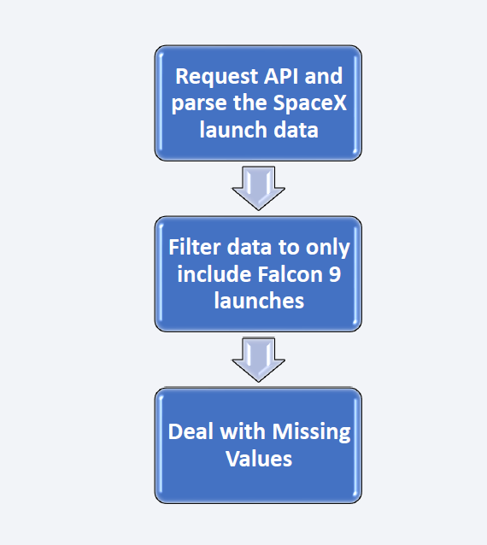
Data Collection – SpaceX API
We used the get request to the SpaceX API (publicly available) to collect and clean the requested data and did some basic data wrangling and formatting as mentioned in the flowchart beside.
The link to the notebook is: https://github.com/nnrit7/Applied_Data_Science_Capstone/blob/main/1.%20Data%20Collection%20API.ipynb

Slide 10
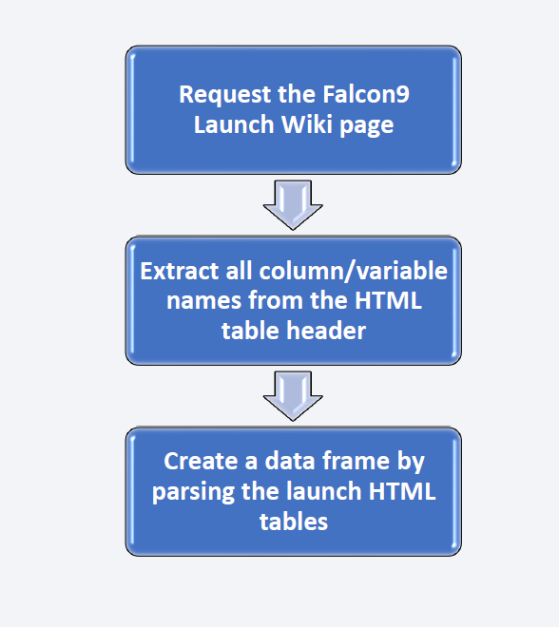
Data Collection - Scraping
We applied web scrapping to web scrap the Falcon 9 launch records with BeautifulSoup. Then we parsed the table and converted it into a pandas dataframe as per the flowchart beside.
The link to the notebook is: https://github.com/nnrit7/Applied_Data_Science_Capstone/blob/main/2.%20Data%20collection%20with%20Web%20Scrapping.ipynb

Slide 11
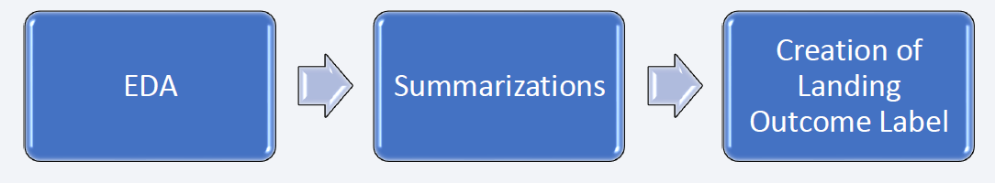
Data Wrangling
We performed exploratory data analysis and determined the training labels.
We calculated the number of launches at each site, and the number and occurrence of each orbits.
We created landing outcome label from outcome column as per the flowchart below and exported the results to csv.
The link to the notebook is: https://github.com/nnrit7/Applied_Data_Science_Capstone/blob/main/3.%20Data%20Wrangling.ipynb

Slide 12

Data Wrangling
LEO: It is an Earth-centred orbit with an altitude of 2,000 km (1,200 mi) or less.
HEO: It is a highly elliptical orbit with high eccentricity, usually referring to one around Earth above the altitude of geosynchronous orbit (35,786 km or 22,236 mi).
MEO: It is a geocentric orbit ranging in altitude from 2,000 km (1,200 mi) to just below geosynchronous orbit at 35,786 kilometers (22,236 mi).
GEO: It is a circular geosynchronous orbit 35,786 kilometers (22,236 miles) above Earth's equator and following the direction of Earth's rotation.

Slide 13
EDA with SQL
We loaded the SpaceX dataset using SQLite3 module without leaving the jupyter notebook.
We applied EDA with SQL to get insight from the data. We wrote queries to find out for instance:
The names of unique launch sites in the space mission,
Top 5 launch sites whose name begin with the string ‘CCA’,
Total payload mass carried by boosters launched by NASA (CRS),
Average payload mass carried by booster version F9 v1.1,
The date when the first successful landing outcome in ground pad was achieved,
Names of the boosters which have success in drone ship having payload mass between 4000 to 6000 kg
The total number of successful and failure mission outcomes,
Names of the booster versions which have carried the maximum payload mass,
Failed landing outcomes in drone ship, their booster versions and launch sites names for in year 2015,
The rank of the count of landing outcomes (such as failure(drone ship) or success (ground pad)) between the date 2010-06-04 to 2017-03-20.
The link to the notebook is: https://github.com/nnrit7/Applied_Data_Science_Capstone/blob/main/4.%20EDA%20with%20SQL.ipynb

Slide 14
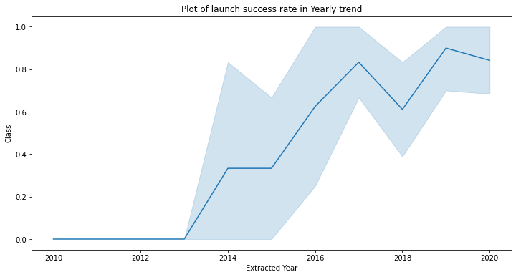
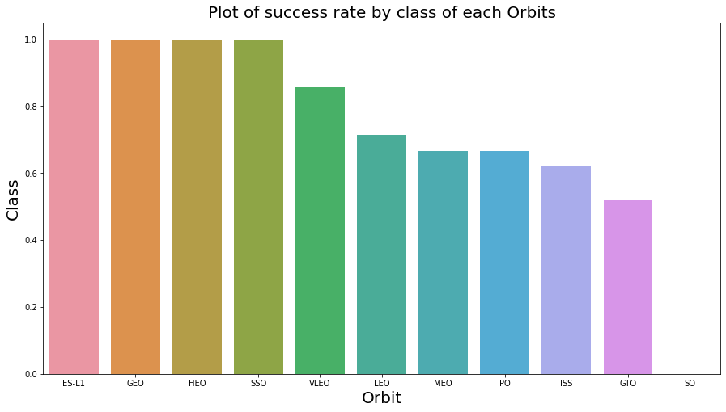
EDA with Data Visualization
We explored the data by visualizing the relationship between flight number and launch Site, payload and launch site, success rate of each orbit type, flight number and orbit type, the launch success yearly trend.
The link to the notebook is: https://github.com/nnrit7/Applied_Data_Science_Capstone/blob/main/5.%20EDA%20with%20Data%20Visualization.ipynb

Slide 15
Build an Interactive Map with Folium
We marked all launch sites, and added map objects such as markers, circles, lines to mark the success or failure of launches for each site on the Folium map.
We assigned the feature launch outcomes (failure or success) to class 0 and 1i.e., 0 for failure, and 1 for success.
Using the color-labeled marker clusters, we identified which launch sites have relatively high success rate.
We calculated the distances between a launch site to its proximities. We answered some question for instance:
Are launch sites near railways, highways and coastlines?
Do launch sites keep certain distance away from cities?
The link to the notebook is: https://github.com/nnrit7/Applied_Data_Science_Capstone/blob/main/6.%20Interactive%20Visual%20Analytics%20with%20Folium%20Lab.ipynb

Slide 16
Build a Dashboard with Plotly Dash
We built an interactive dashboard with Plotly dash.
We plotted pie charts showing the total launches by a certain sites.
We plotted scatter graph showing the relationship with Outcome and Payload Mass (Kg) for the different booster version.
The link to the notebook is: https://github.com/nnrit7/Applied_Data_Science_Capstone/blob/main/7.%20SpaceX%20Launch%20Records%20Dashboard%20App.py

Slide 17
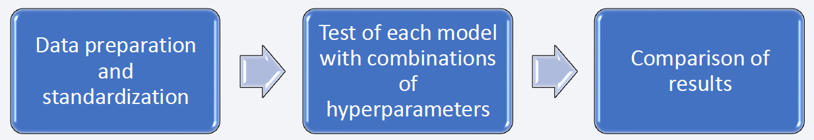
Predictive Analysis (Classification)
We loaded the data using numpy and pandas, transformed the data, split our data into training and testing. Then we built different machine learning models and tune different hyperparameters using GridSearchCV. We used accuracy as the metric for our model, improved the model using feature engineering and algorithm tuning.
After comparing four classification models (Logistic Regression, Support Vector Machine, Decision Tree Classifier and K-Nearest neighbors) we found the best performing classification model.
The link to the notebook is: https://github.com/nnrit7/Applied_Data_Science_Capstone/blob/main/8.%20Machine%20Learning%20Prediction.ipynb

Slide 18
Results
Exploratory data analysis results:
SpaceX uses 4 different launch sites;
The first launches were done to SpaceX itself and NASA;
The average payload of F9 v1.1 booster is 2,928 kg;
The first success landing outcome happened in 2015 fiver year after the first launch;
Many Falcon 9 booster versions were successful at landing in drone ships having payload above the average;
Almost 100% of mission outcomes were successful;
Two booster versions failed at landing in drone ships in 2015: F9 v1.1 B1012 and F9 v1.1 B1015;
The number of landing outcomes became as better as years passed.

Slide 19
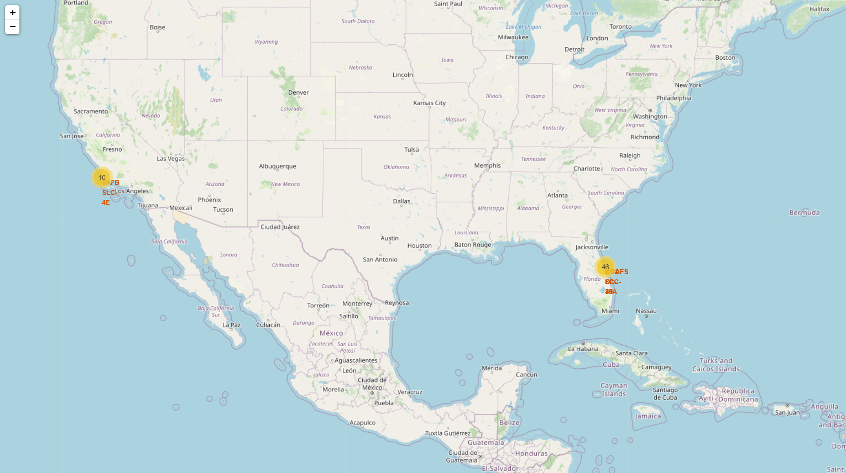
Results
Interactive data analysis results:
Launch sites are far away from localities but highway and railway is present for communication.
Launch sites are use to be in safety places like near sea and have a good logistic infrastructure around.
Most launches happens at east coast launch sites.

Slide 20
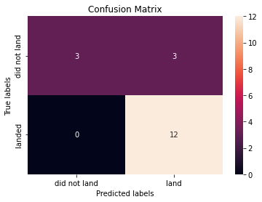
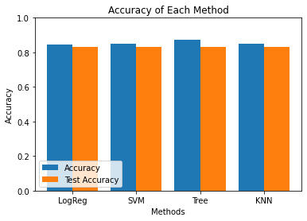
Results
Predictive data analysis results:
Amongst all models that we tested Decision Tree Classifier is came out as best model to predict successful landings having accuracy over 87% and accuracy for test over 83%.

Slide 21

Section 2

Slide 22
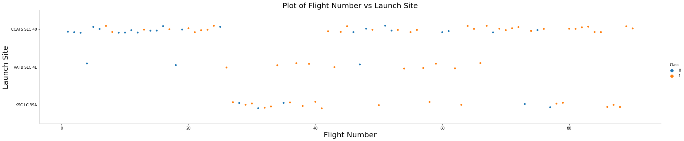
Flight Number vs. Launch Site
According to the plot below, it’s possible to verify that the best launch site nowadays is CCAF5 SLC 40, where most of recent launches were successful.
In second place VAFB SLC 4E and third place KSC LC 39A.
It’s also possible to see that the general success rate improved over time.

Slide 23
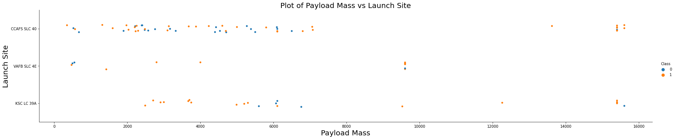
Payload vs. Launch Site
According to the plot below, payloads over 9,000kg (about the weight of a school bus) have excellent success rate.
Payloads over 12,000kg seems to be possible only on CCAFS SLC 40 and KSC LC 39A launch sites.

Slide 24
Success Rate vs. Orbit Type
According to the plot beside, the biggest success rates happens to orbits as:
ES-L1
GEO
HEO
SSO
Followed by orbits as:
VLEO (above 80%)
LFO (above 70%)

Slide 25
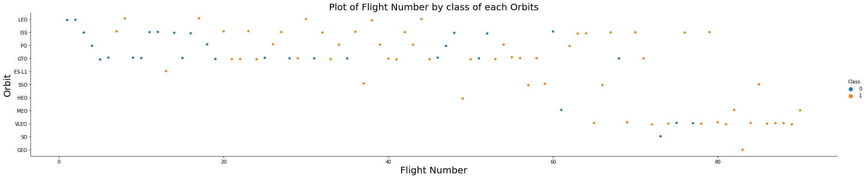
Flight Number vs. Orbit Type
Apparently from to the plot below, success rate improved over time to all orbits.
VLEO orbit seems a new business opportunity, due to recent increase of its frequency.

Slide 26
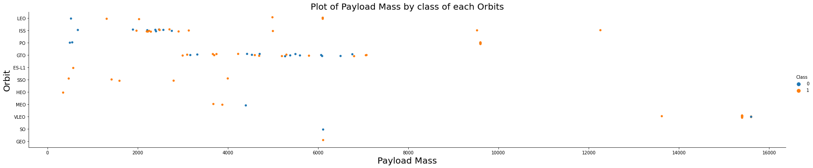
Payload vs. Orbit Type
Apparently from to the plot below, there is no relation between payload and success rate to orbit GTO.
ISS orbit has the widest range of payload and a good rate of success.
There are few launches to the orbits SO and GEO.

Slide 27
Launch Success Yearly Trend
According to the plot beside, success rate started increasing from 2013 and kept until 2020.
It seems that the first three years were a period of adjusts and improvement of technology.

Slide 28
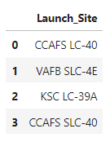
All Launch Site Names
According to data, there are four launch sites:
They are obtained by selecting unique occurrences of “Launch_Site” values from the dataset.

Slide 29
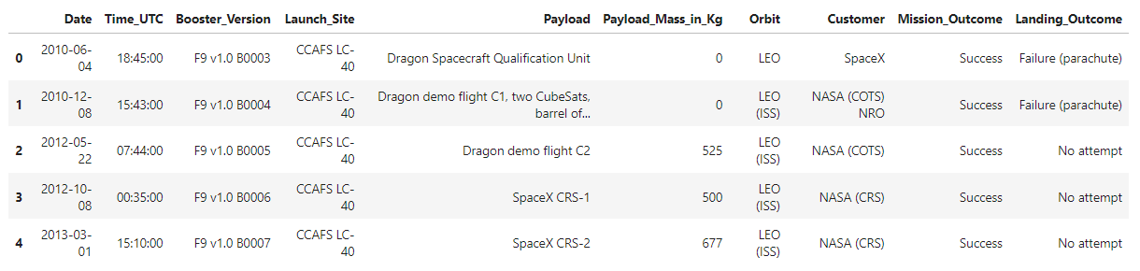
Launch Site Names Begin with 'CCA'
5 records where launch sites begin with ‘CCA’:
Here we can see five samples of Cape Canaveral launches.

Slide 30
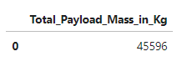
Total Payload Mass
Total payload carried by boosters from NASA:
Total payload calculated above, by summing all payloads whose codes contain ‘CRS’, which corresponds to NASA.

Slide 31
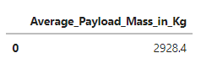
Average Payload Mass by F9 v1.1
Average payload mass carried by booster version F9 v1.1:
Filtering data by the booster version above and calculating the average payload mass we obtained the value of 2,928 kg.

Slide 32
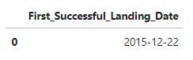
First Successful Ground Landing Date
First successful landing outcome on ground pad:
By filtering data by successful landing outcome on ground pad and getting the minimum value for date it’s possible to identify the first occurrence, that happened on 12/22/2015.

Slide 33
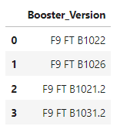
Successful Drone Ship Landing with Payload between 4000 and 6000
List of the boosters which have successfully landed on drone ship and had payload mass greater than 4000 but less than 6000:
Selecting distinct booster versions according to the filters above, these 4 are the result.

Slide 34
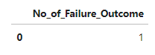
Total Number of Successful and Failure Mission Outcomes
Number of successful and failure mission outcomes:
Grouping mission outcomes and counting records for each group led us to the summary above.

Slide 35
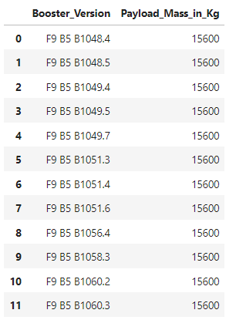
Boosters Carried Maximum Payload
Boosters which have carried the maximum payload mass:
These are the boosters which have carried the maximum payload mass registered in the dataset.

Slide 36
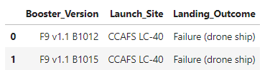
2015 Launch Records
Failed landing outcomes in drone ship, their booster versions, and launch site names for in year 2015:
The list above has the only two occurrences.

Slide 37
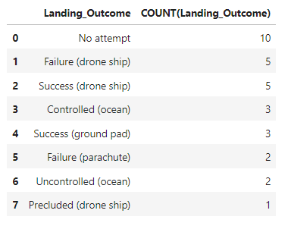
Rank Landing Outcomes Between 2010-06-04 and 2017-03-20
Ranking of all landing outcomes (such as Failure (drone ship) or Success (ground pad)) between the date 2010-06-04 and 2017-03-20, in descending order:
This view of data alerts us that “No attempt” must be taken in account.

Slide 38

Section 3

Slide 39
All Launch Sites Global Map Markers
Launch sites are near to sea and far from locality having good logistic infrastructure and communication by highway and railway.

Slide 40
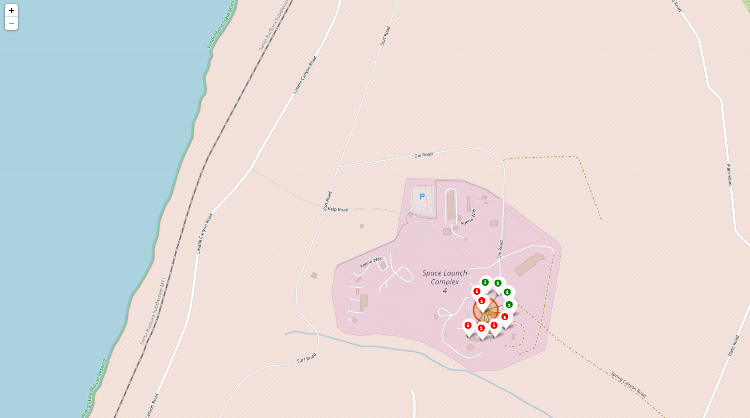
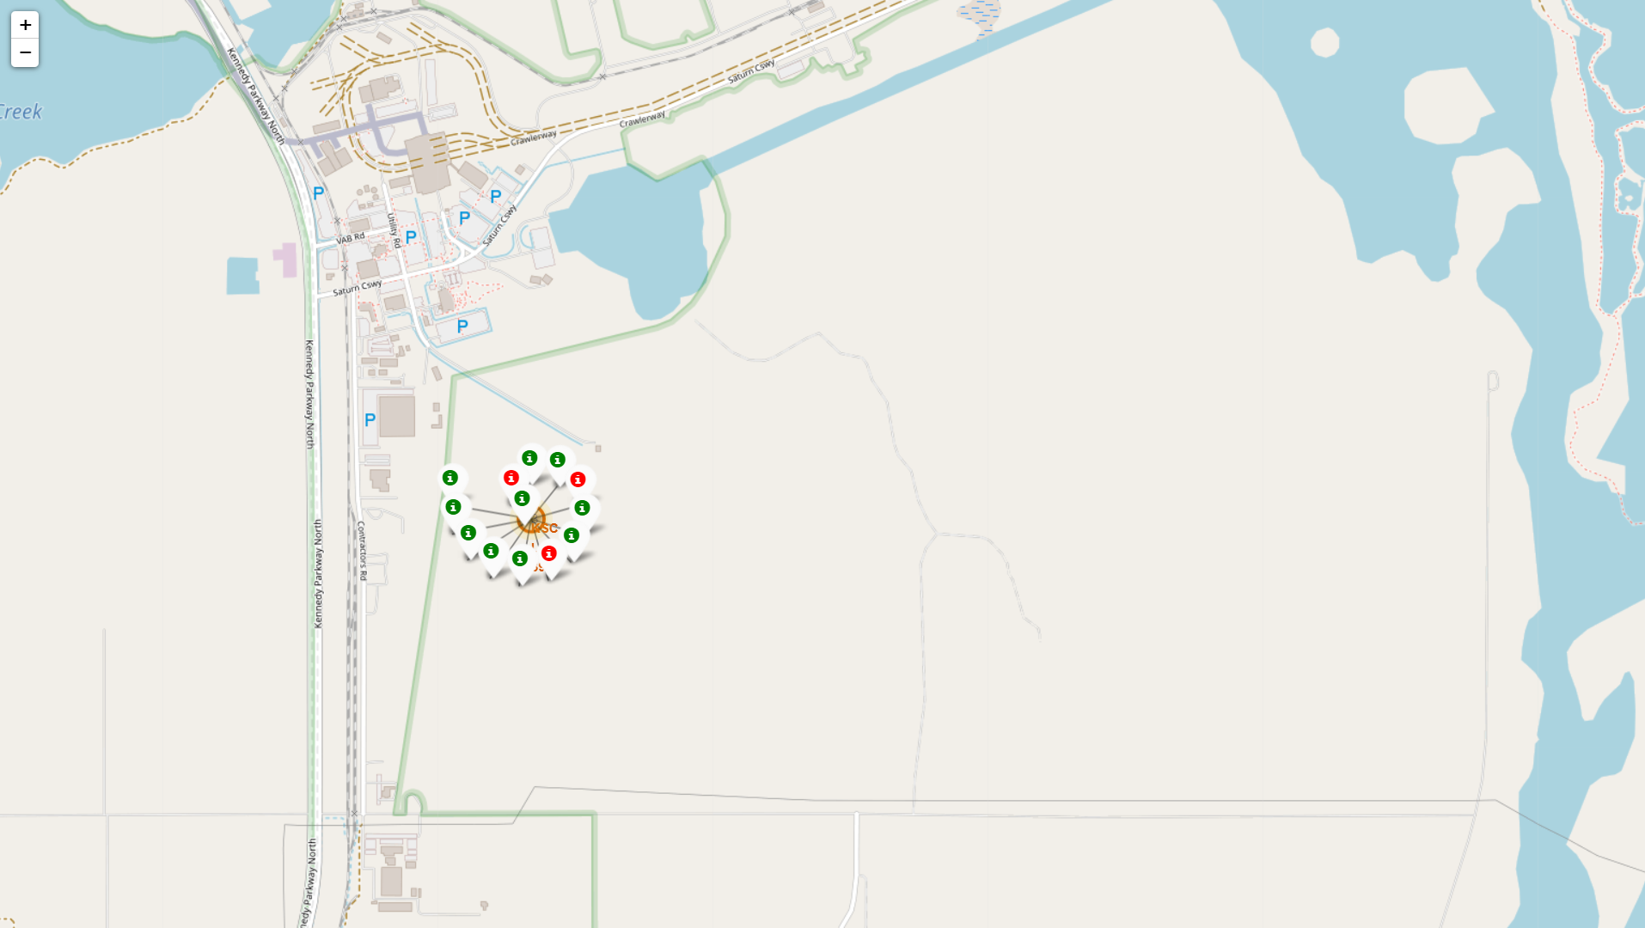
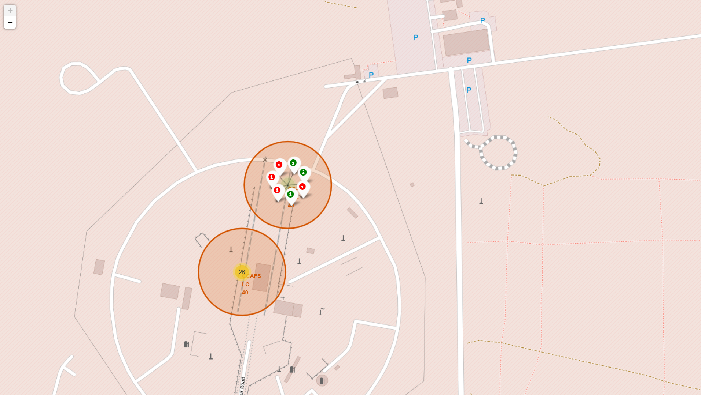
Launch sites Showing by Markers with Color Labels
Launch site outcomes for VAFB SLC-4E, KSC LC-39A, CCAFS SLC-40 and CCAFS LC-40 (left to right).
Green markers indicate successful and red ones indicate failure.

Slide 41
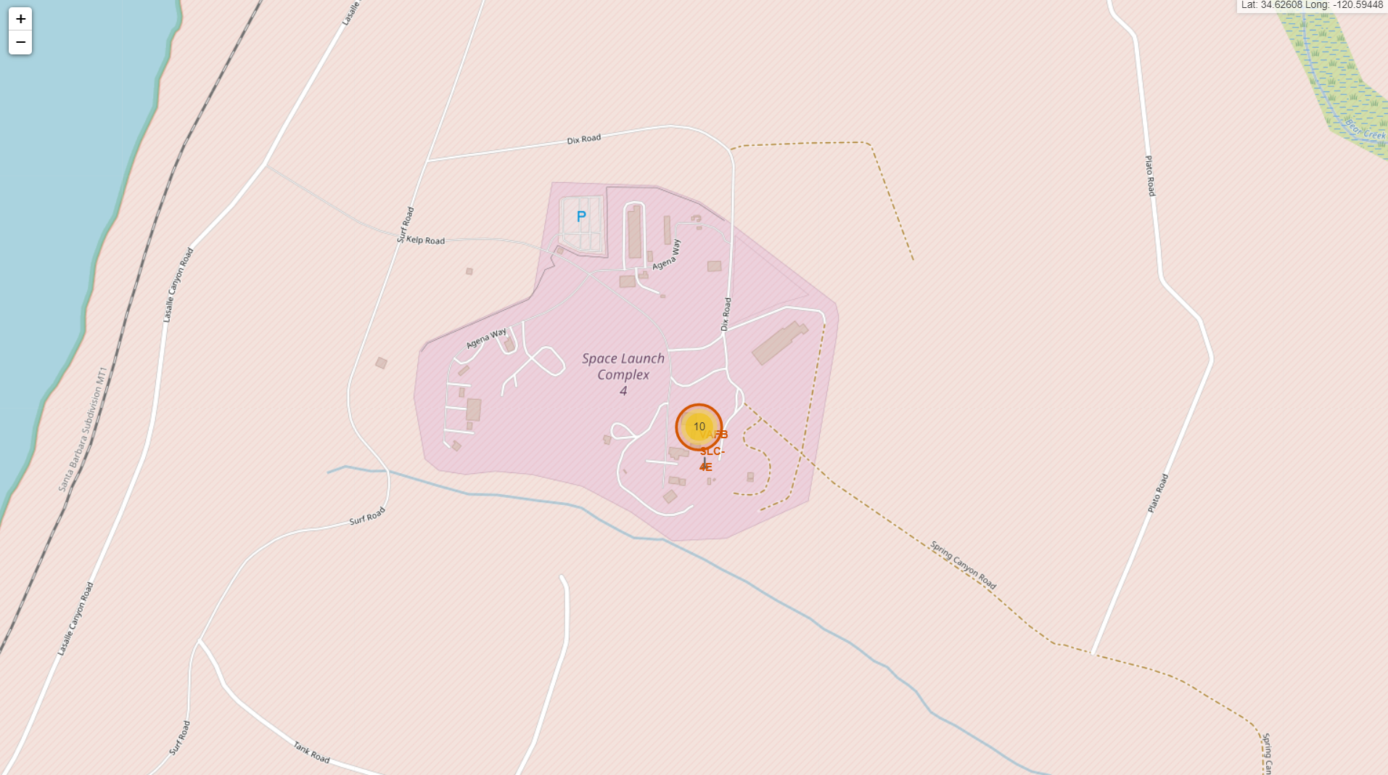
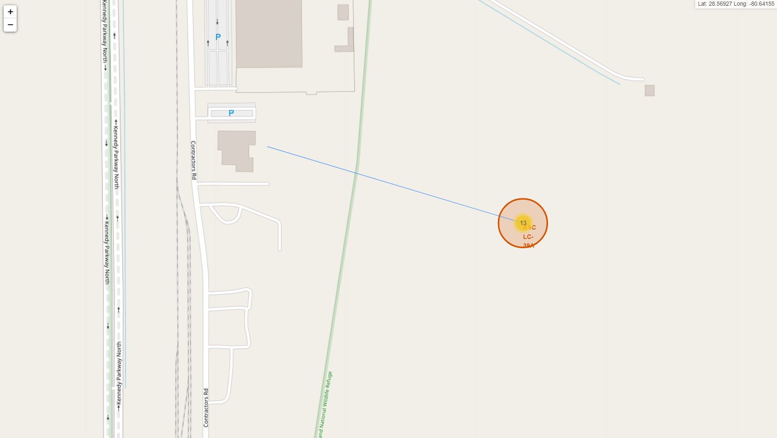
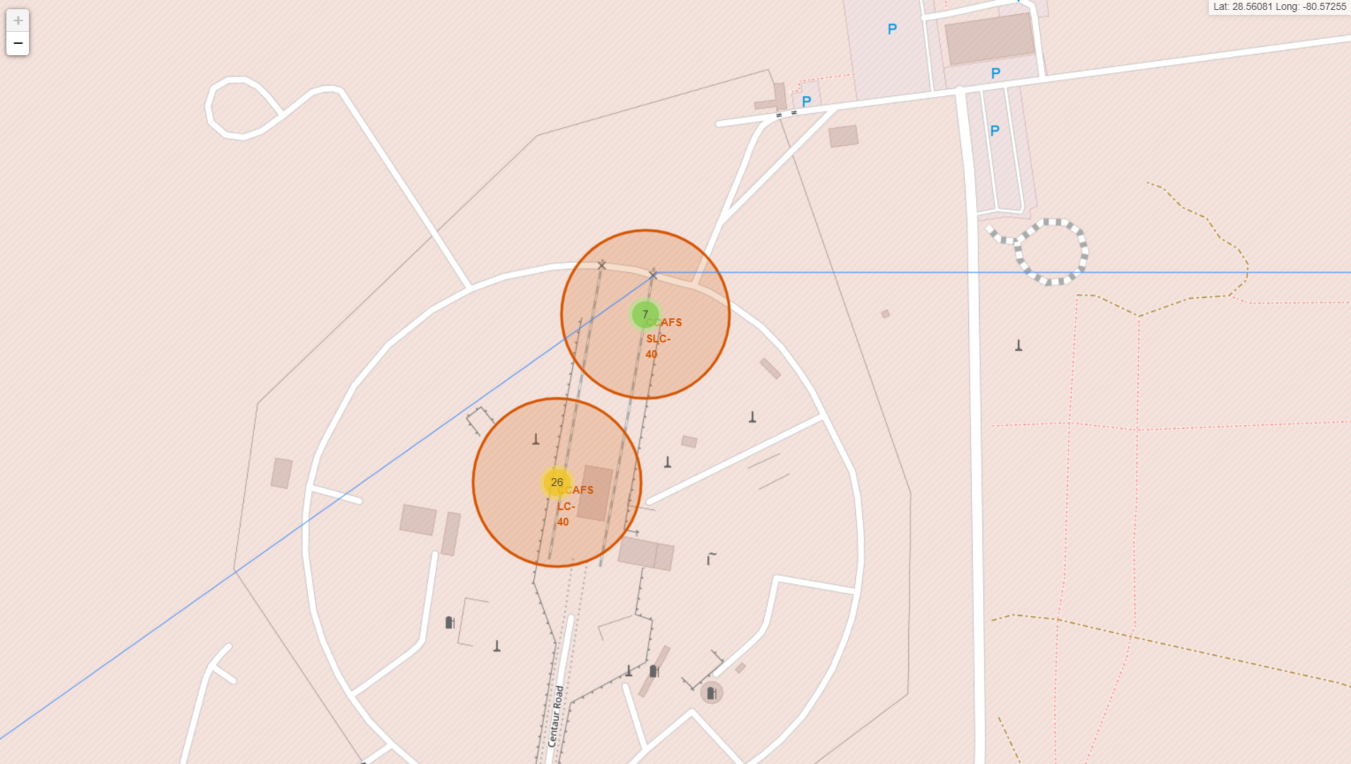
Launch Sites
Launch sites (VAFB SLC-4E, KSC LC-39A, CCAFS SLC-40 and CCAFS LC-40 (left to right)) have good logistics aspects along with railways and highways nearby but not very close. Launch sites are also far away from localities and close to coastline.

Slide 42

Section 4

Slide 43
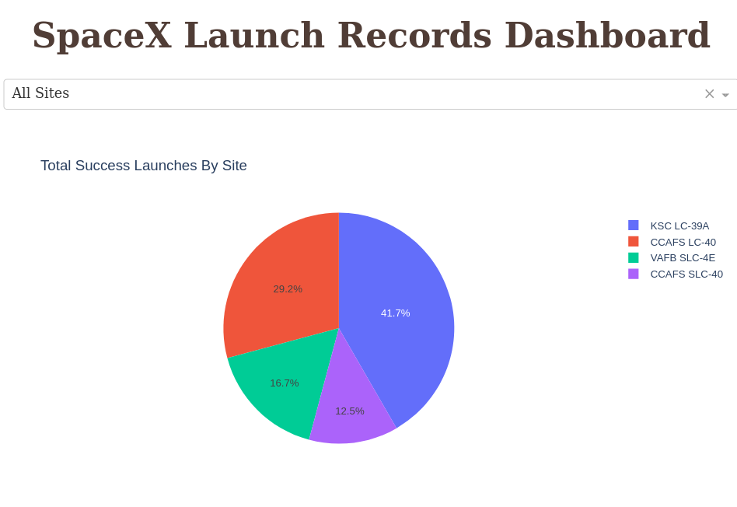
Pie Chart Showing Successful Launches by Site
The place from where launches are done seems to be a very important factor of success of missions.

Slide 44
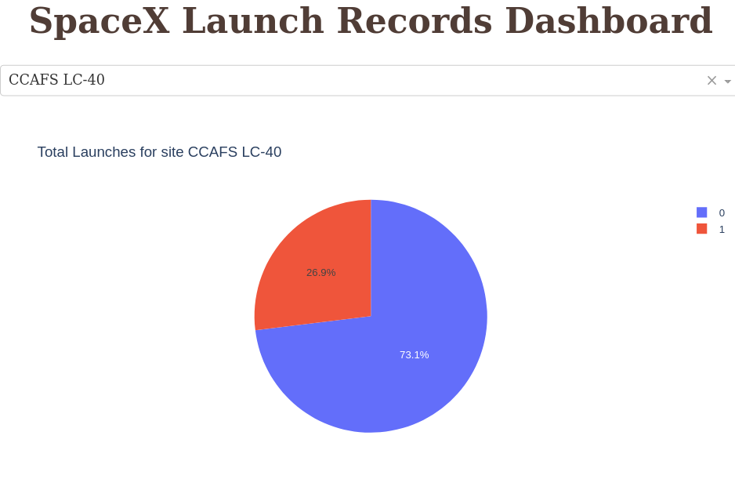
Pie Chart Showing Launch Success Ratio for Launching Sites
73.1% and 76.9% of launches are successful for CCAFS LC-40 and KSC LC-39A launching sites.

Slide 45
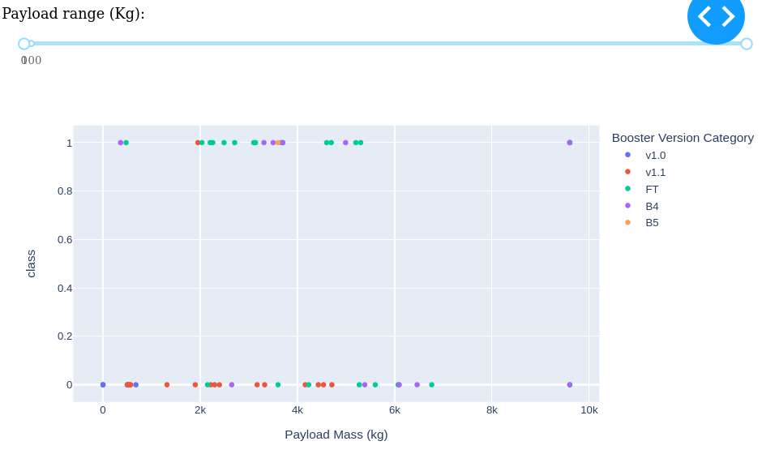
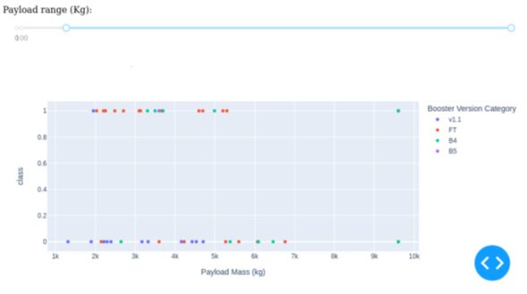
Graph for Payload vs Launch Outcome
Most of the launches are done by v1.1 and FT boosters.
Payloads under 6000 kg and FT boosters are the most successful combination.

Slide 46
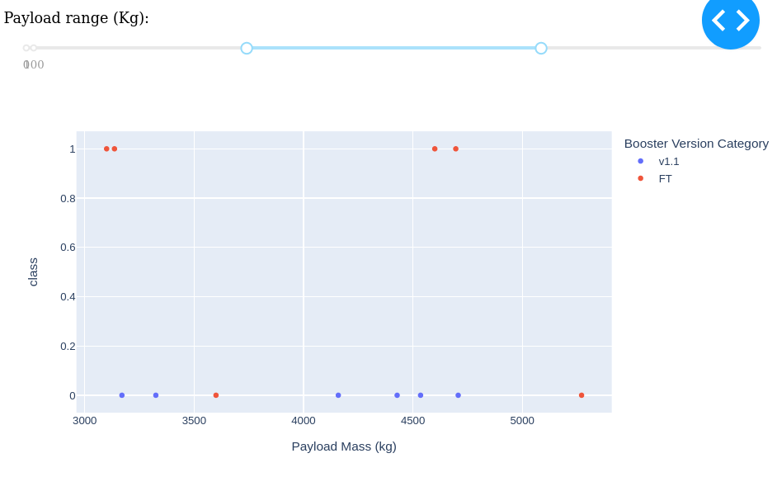
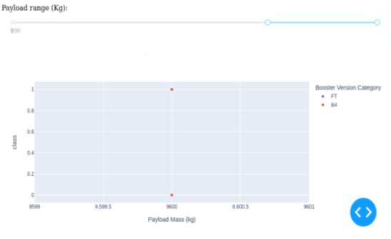
Graph for Payload vs Launch Outcome
Success rate for FT booster version with payload between 4000 to 7000 kg is 100%.
There’s not enough data to estimate risk of launches over 7,000 kg.

Slide 47

Section 5

Slide 48
Classification Accuracy
Four classification models were tested, and their accuracies are plotted beside.
The model with the highest classification accuracy is Decision Tree Classifier, which has accuracies over than 87%.

Slide 49
Confusion Matrix
Confusion matrix of Decision Tree Classifier proves its accuracy by showing the big numbers of true positive and true negative compared to the false ones.

Slide 50
Conclusions
We can conclude that:
The larger the flight amount at a launch site, the greater the success rate at a launch site.
Although most of mission outcomes are successful, successful landing outcomes seem to improve over time, according the evolution of processes and rockets. Launch success rate started to increase in 2013 till 2020.
Orbits ES-L1, GEO, HEO, SSO, VLEO had the most success rate.
KSC LC-39A had the most successful launches of any sites.
Launches above 7,000kg are less risky.
The Decision tree classifier is the best machine learning algorithm for this task.

Slide 51
Appendix
Google Colaboratory were used for analysis for its user friendliness and simplicity.
All ipynb and py files were uploaded in Github repository.
Folium and Plotly dash didn’t show maps on Github repository, instead screenshots were uploaded.
All csv files, graphs, charts, plots, flowchart images are uploaded in Github repository.

Slide 52


